Slide 1
Credit Risk Modeling

Slide 2
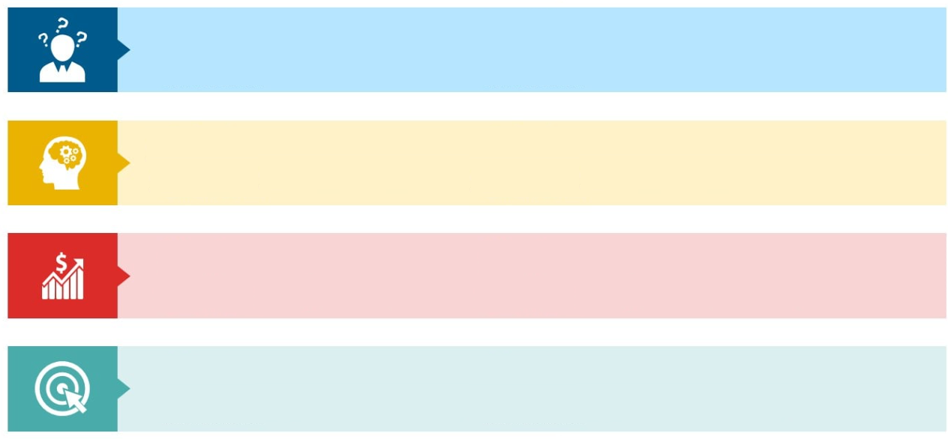
Executive Summary
Problem Current credit approval strategy results in an overall default rate of 24.65% leading to increased company costs and reduced profits.
Solution Utilize the outcomes of a credit risk assessment model, which forecasts the likelihood of default (PD), to inform the determination of whether to approve a credit application.
Strategy Approve applicants with a conservative PD < 40% or an aggressive PD < 60%.
Goals Implemented strategy reduces the overall default rate within 5% to 10% leading to decreased costs and increased profits.
Notes:
The conservative strategy has a lower threshold compared with the aggressive one; hence accepts less applicants.

Slide 3
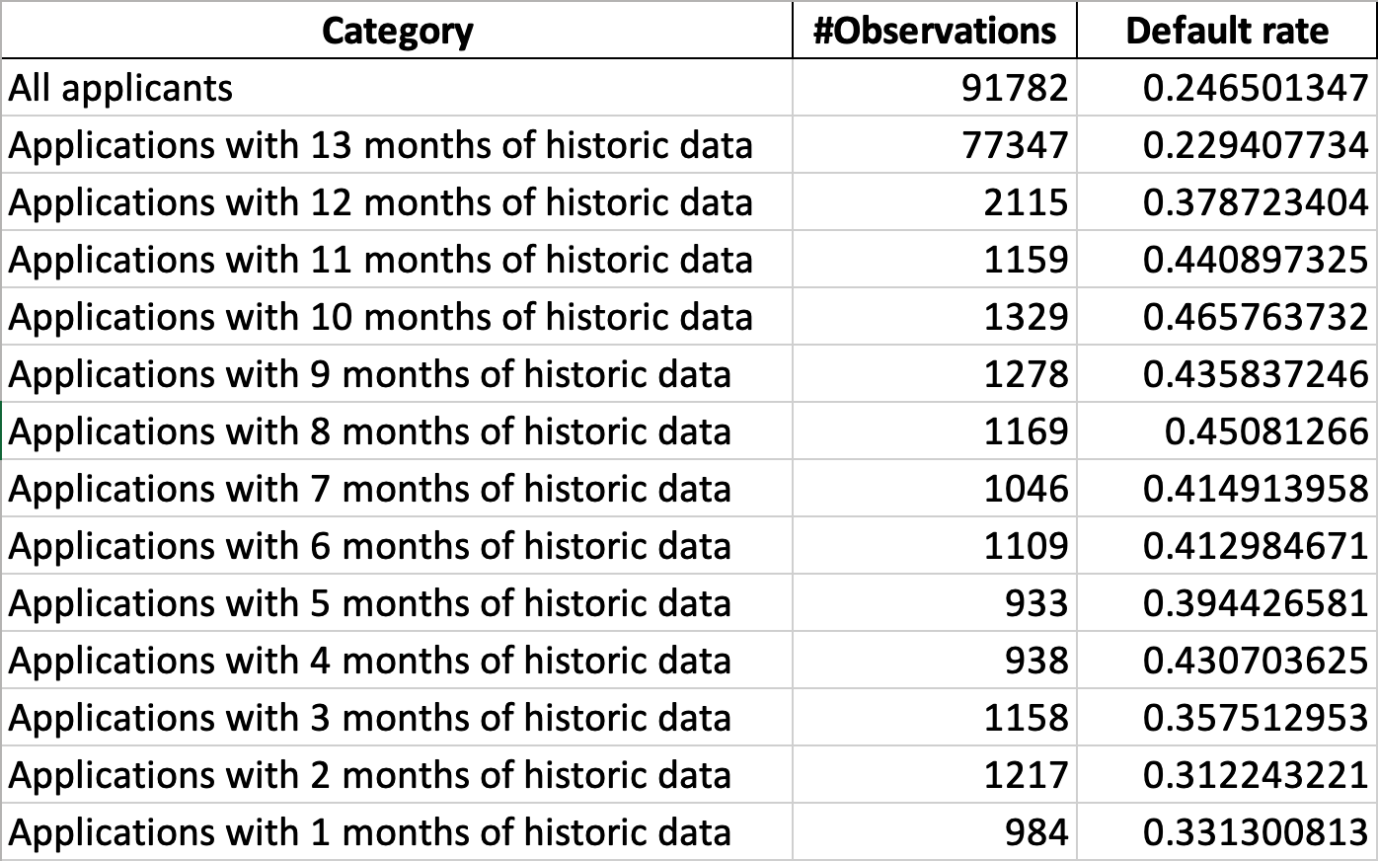
Data

Slide 4
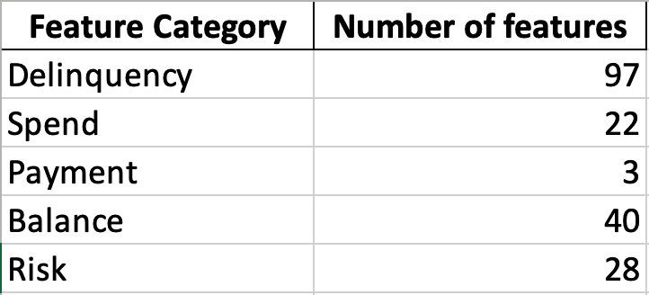
Features

Slide 5
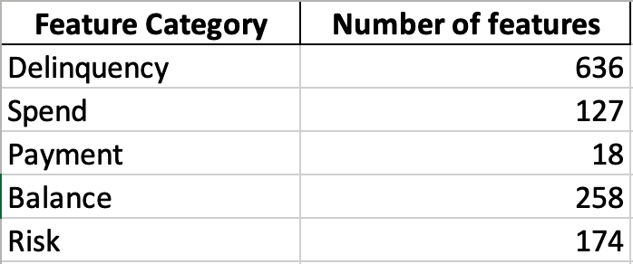
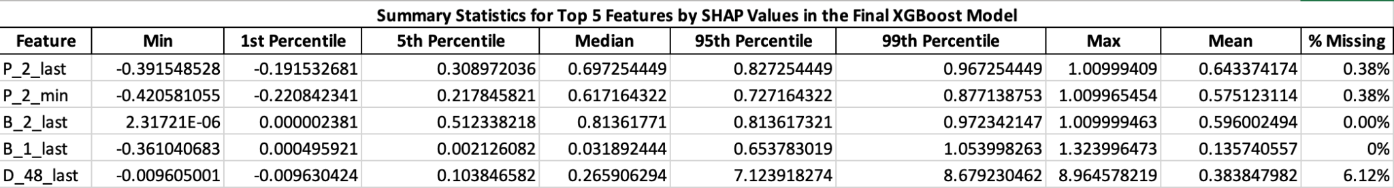
Feature Engineering
Numeric Features
Mean of the column
Standard Deviation of the data
Min of that feature
Max of the variable
Last Value in the column
Aggregation Across Customers
Categorial Features
Response Rate in Last 6 Months
Ever Response in Last 12 Months
Creation of New Features
Handling of Missing Values

Slide 6
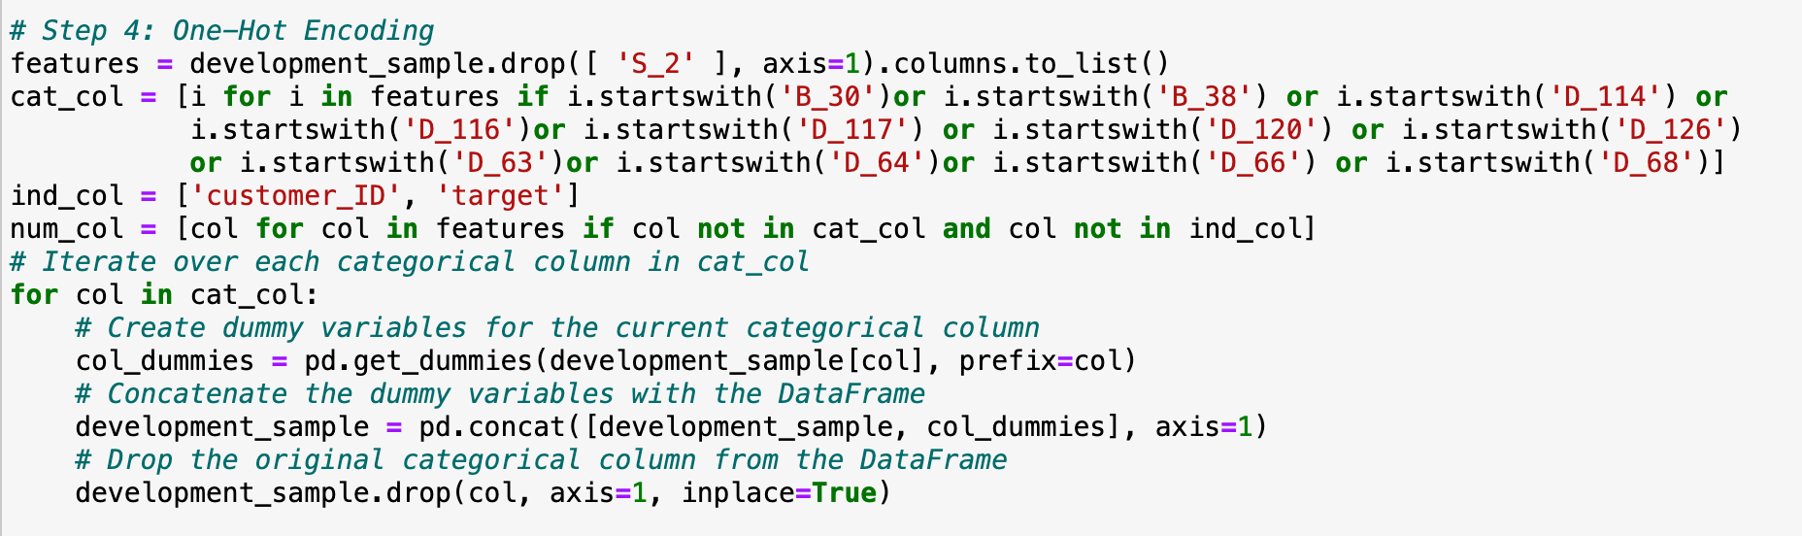
Data Processing – One Hot Encoding
11 Categorical features processed with One-Hot Encoding.
45 Indicator features created retaining the original categorical feature name suffixed with discrete values from each category.

Slide 7
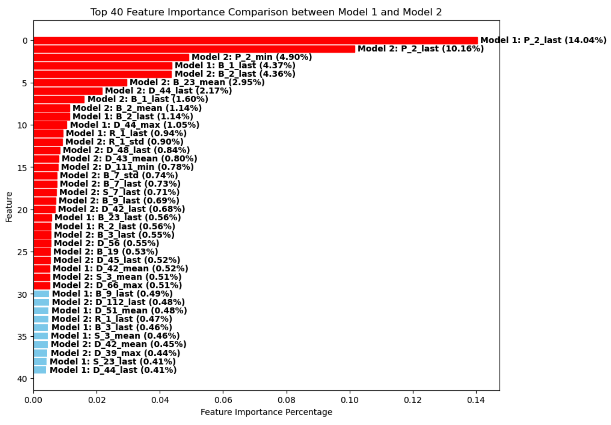

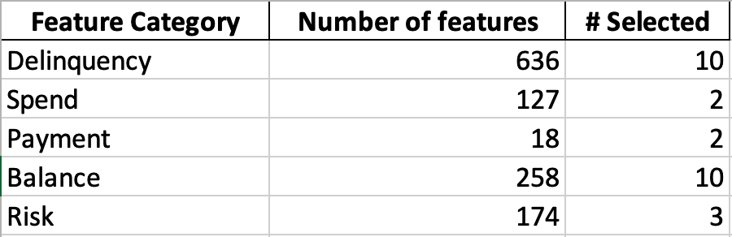
Feature Selection
Feature importance was calculated from two XGBoost models trained on the training dataset.
Selected features have a feature importance of higher than 0.5% in any of the two models.
Notes:
27 feature in total were selected

Slide 8
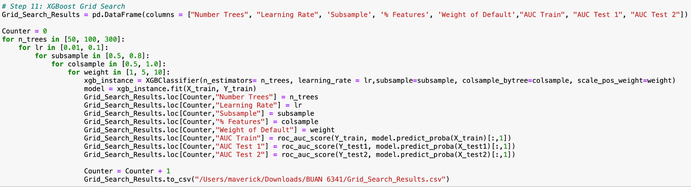
XGBoost - Grid Search
Notes:
Used for loops to run different combinations of models
Trained the model on these combinations and saved the AUC scores of train test 1 and test2 to a df
Saved the df after each iteration to minimise data loss in case of kernel crash

Slide 9
XGBoost - Grid Search
Grid Search Implementation: Implemented grid search to explore parameter combinations systematically.
Number of Models Trained: Trained multiple models by iterating over 72 different parameter combinations.
Lessons Learned: Discovered the impact of parameters on model performance and identified optimal settings.
Optimization Process: Iteratively adjusted parameters to enhance model performance on evaluation metrics.
Balancing Act: Balanced model complexity with performance, prioritizing parameter combinations yielding the best results.
Efficiency Improvements: Streamlined grid search to optimize computational resources while maximizing effectiveness.
Optimal Parameter Identification: Identified parameter configurations maximizing AUC on training and test datasets.
Generalization Insights: Explored how parameter settings affected model generalization to unseen data, ensuring robustness.
Notes:
We identified parameter combinations that maximized auc while ensuring robustness against unseen data
This iterative process was crucial for refining our model and achieving high predictive accuracy

Slide 10
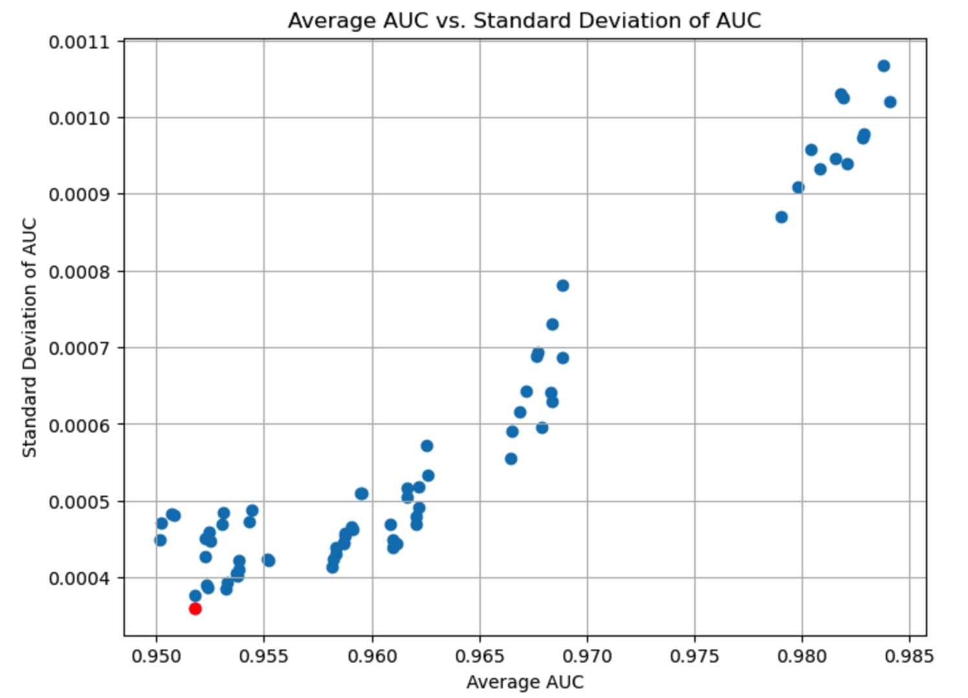
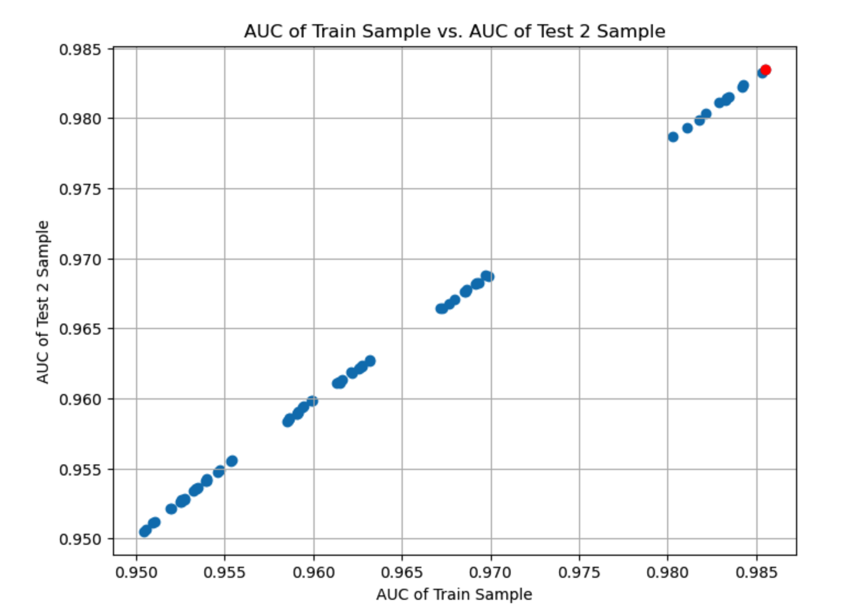
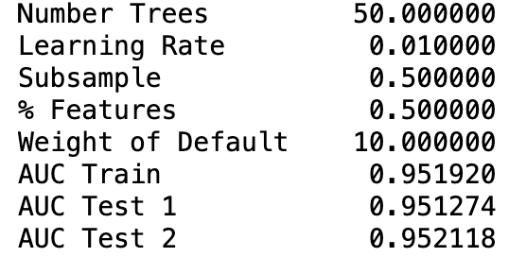
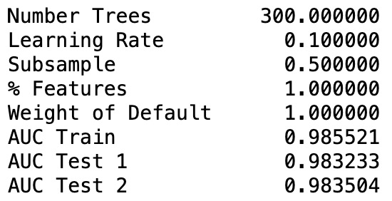
XGBoost - Grid Search

Slide 11
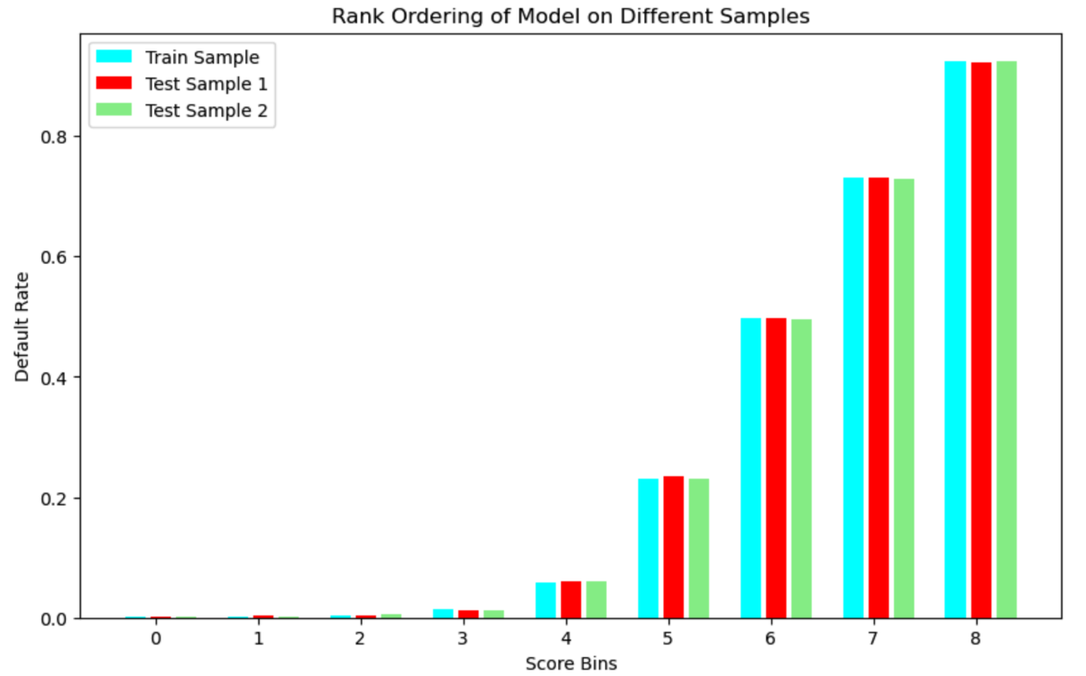
XGBoost – Final Model
Notes:
In the final model yhat we went with is the model with high avg. AUC. The graph typically shows how the default rate varies across different score bins. Ideally, we'd expect the default rate to increase as you move from low-scoring bins to high-scoring bins. This indicates that instances with higher scores (predicted as lower risk) are less likely to result in the event of interest (e.g., default), while instances with lower scores (predicted as higher risk) are more likely to result in the event.

Slide 12
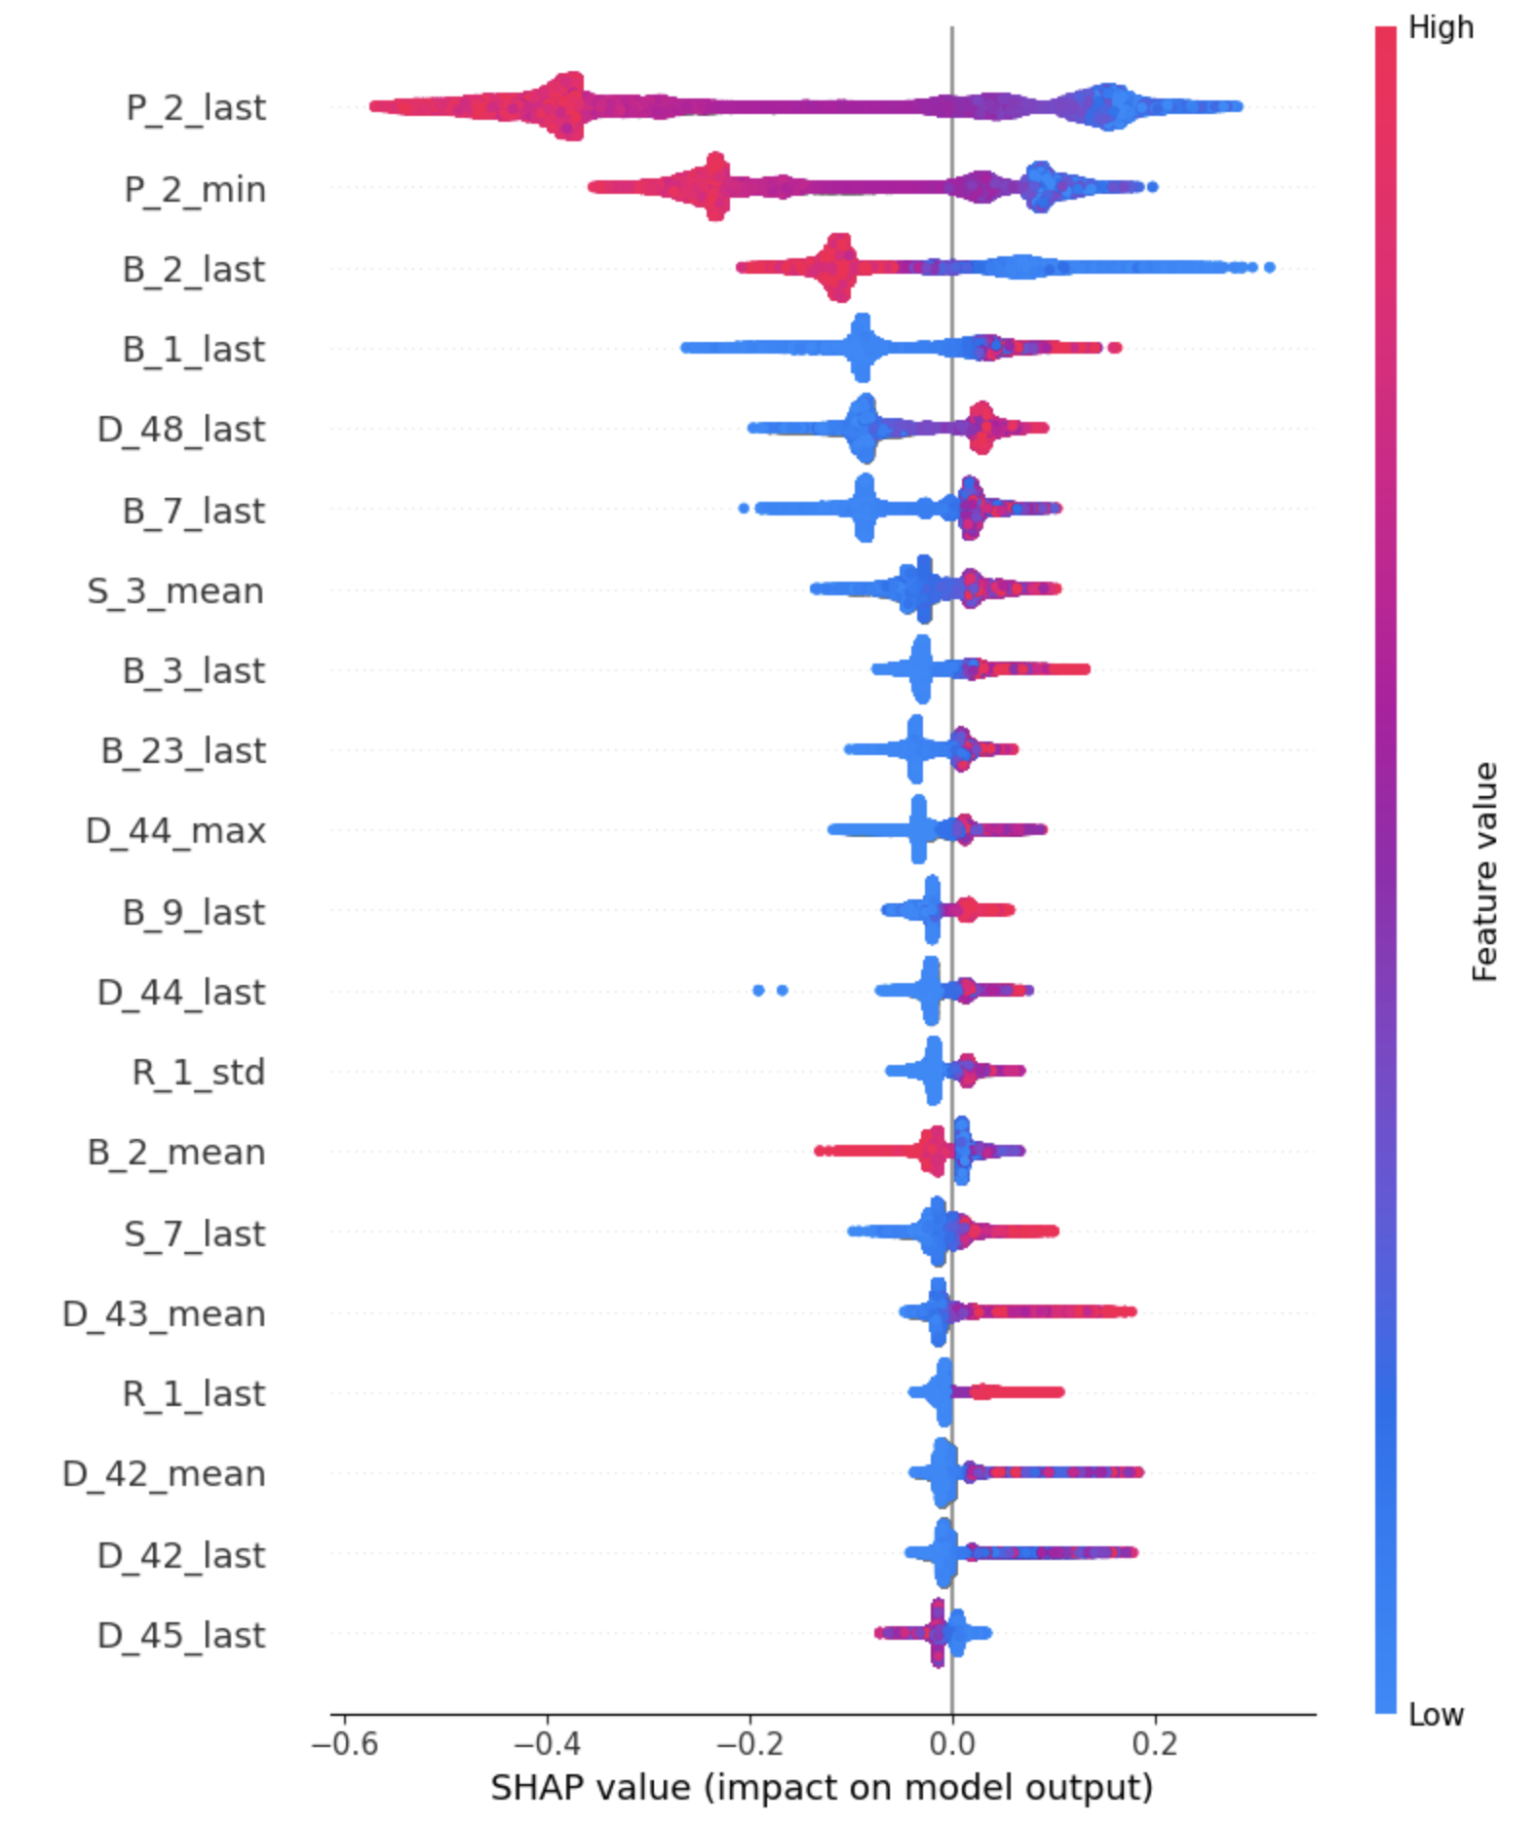
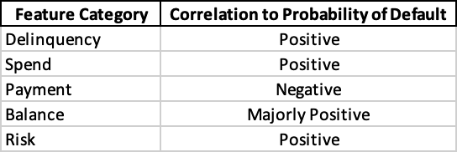
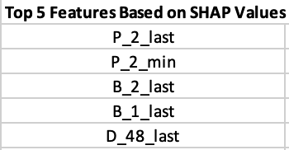
XGBoost – SHAP Analysis
SHAP Beeswarm Graph
Final XGBoost model applied to Test 2 sample
Notes:
SHAP values can help you see which features are most important for the model and how they affect the outcome.
Y-axis indicates the feature names in order of importance from top to bottom.
X-axis represents the SHAP value, which indicates the degree of change in log odds.
The color of each point on the graph represents the value of the corresponding feature, with red indicating high values and blue indicating low values.
So, in P2 we see it has see that it is mostly high with a negative SHAP value. It means higher complaint counts tend to negatively affect the output.

Slide 13
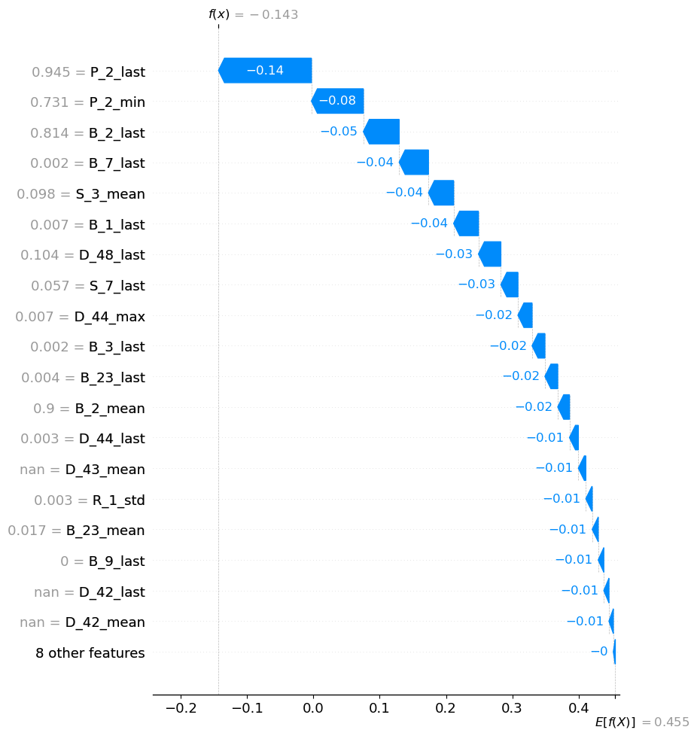
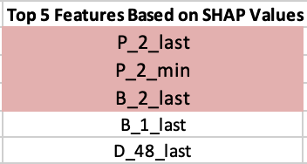
XGBoost – SHAP Analysis
SHAP Waterfall Graph
Top Feature Contribution to the PD is 25.78%
3 of the top 5 features make significant contributions to the PD:
Notes:
A SHAP waterfall plot illustrates how each feature contributes to the final model prediction for a single instance.
Y axis - features
X axis - x-axis typically represents the contribution of each feature to the model's prediction
Positive contributions push the prediction higher, while negative contributions push it lower.

Slide 14
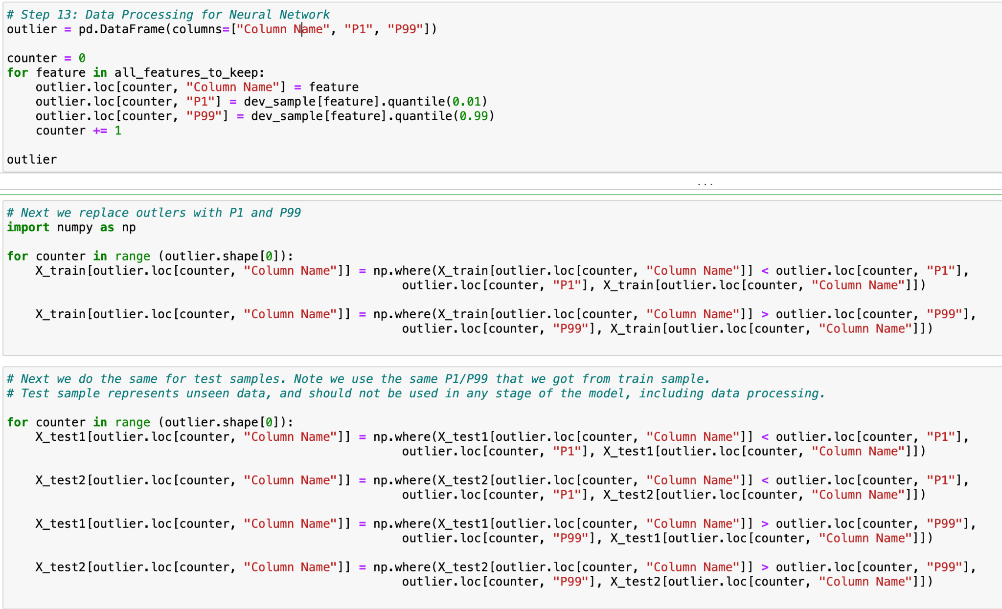
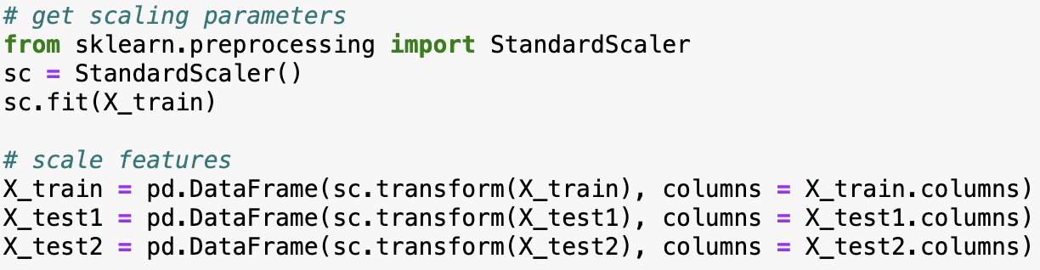
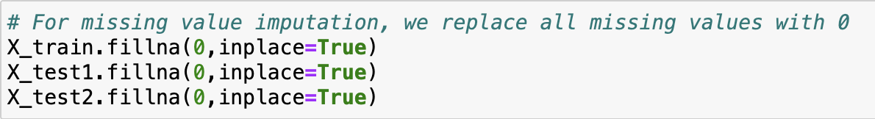
Neural Network – Data Processing
1% floor
99% cap
Outlier Treatment
StandardScalar()
Feature Scaling
Replace missing values with 0
Missing Value Imputation

Slide 15
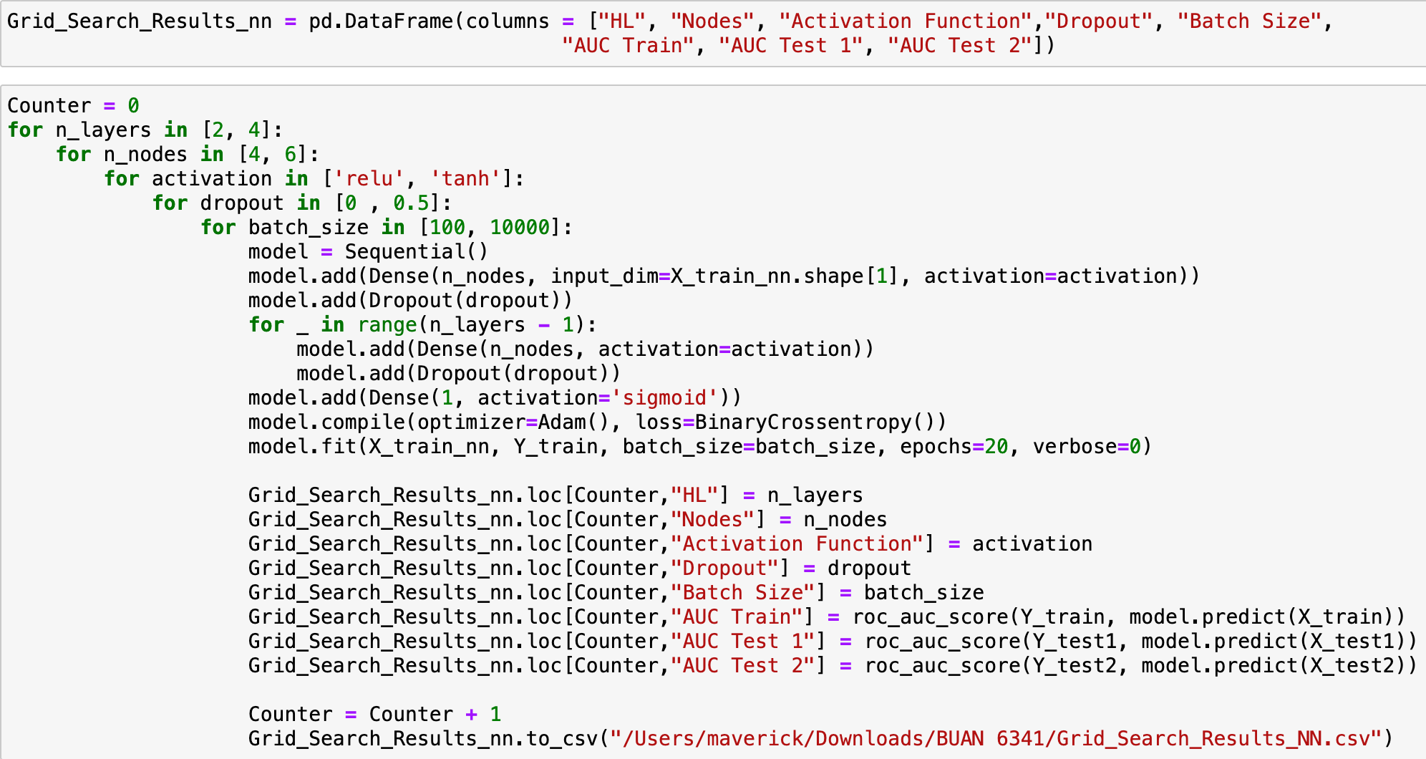
Neural Network - Grid Search

Slide 16
Neural Network - Grid Search
Number of Hidden Layers (n_layers): We consider 2 and 4 hidden layers. This choice allows us to explore both simpler and more complex architectures to see which one performs better on our data.
Number of Nodes per Layer (n_nodes): We explore two options: 4 and 6 nodes per layer. This parameter controls the model's capacity and complexity. By testing different numbers of nodes, we can find the optimal balance between model complexity and performance.
Activation Function (activation): We consider both ReLU and tanh activation functions. ReLU is widely used and often provides good performance, while tanh can capture more complex patterns in the data. Testing both allows us to see which one works better for our problem.
Dropout Rate (dropout): We experiment with dropout rates of 0 and 0.5. Dropout is a regularization technique used to prevent overfitting by randomly dropping a fraction of input units during training. Testing different dropout rates helps us find the optimal level of regularization.
Batch Size (batch_size): We try two batch sizes: 100 and 10,000. Batch size affects the speed and stability of the training process. Smaller batch sizes may lead to more noise in the optimization process but can result in faster convergence, while larger batch sizes can provide smoother gradients but may take longer to train.
This grid search explores a total of :-
2×2×2×2×2=32
2×2×2×2×2=32 different combinations of hyperparameters. For each combination, the code trains a neural network model, evaluates its performance on the training set and two test sets (Test 1 and Test 2), and records the results in a dataframe (Grid_Search_Results_nn). Finally, the results are saved to a CSV file for further analysis.
Through grid search, we can gain insights into how different combinations of hyperparameters affect model performance. It helps us understand which hyperparameters are crucial for achieving better results and provides valuable information for building more effective neural network models.

Slide 17
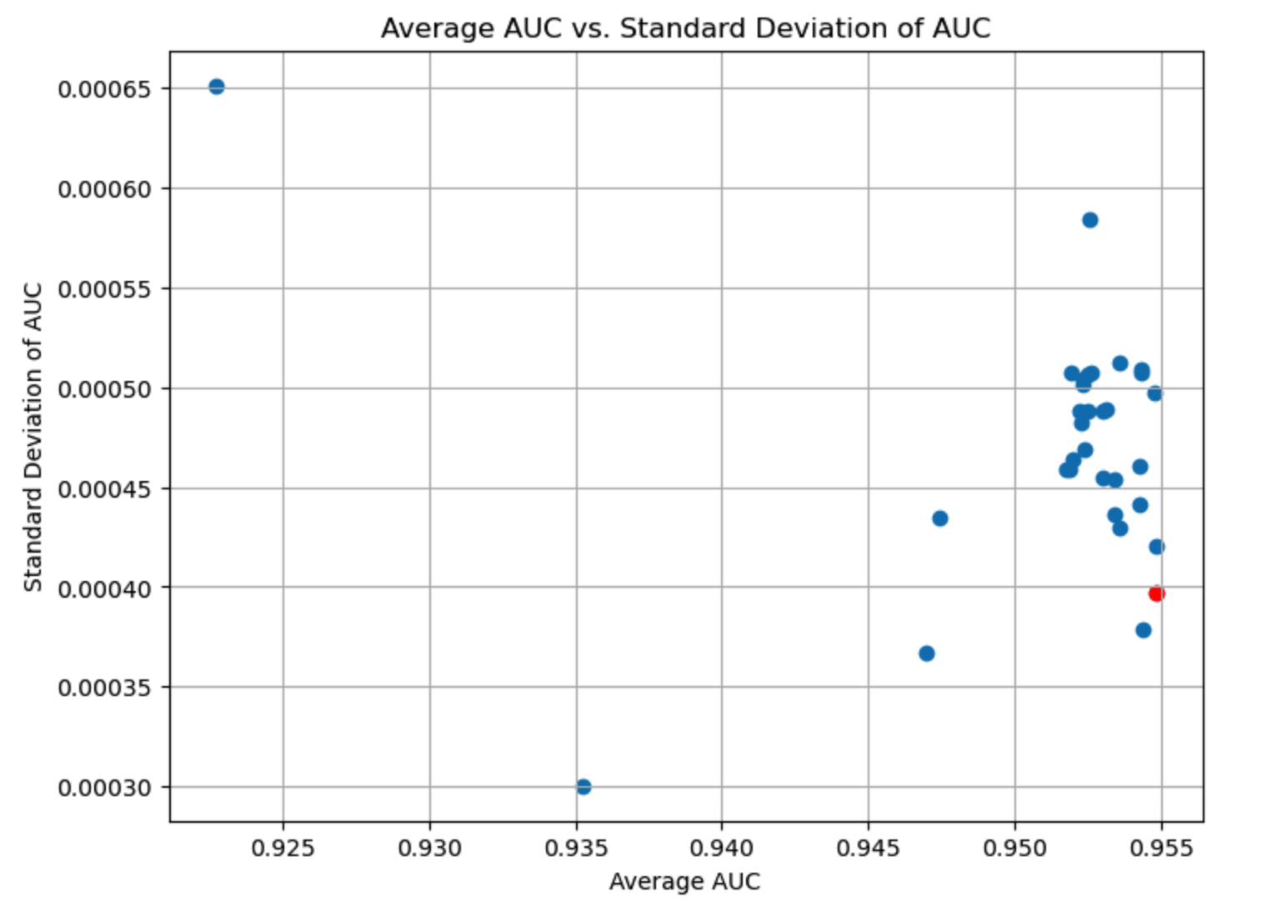
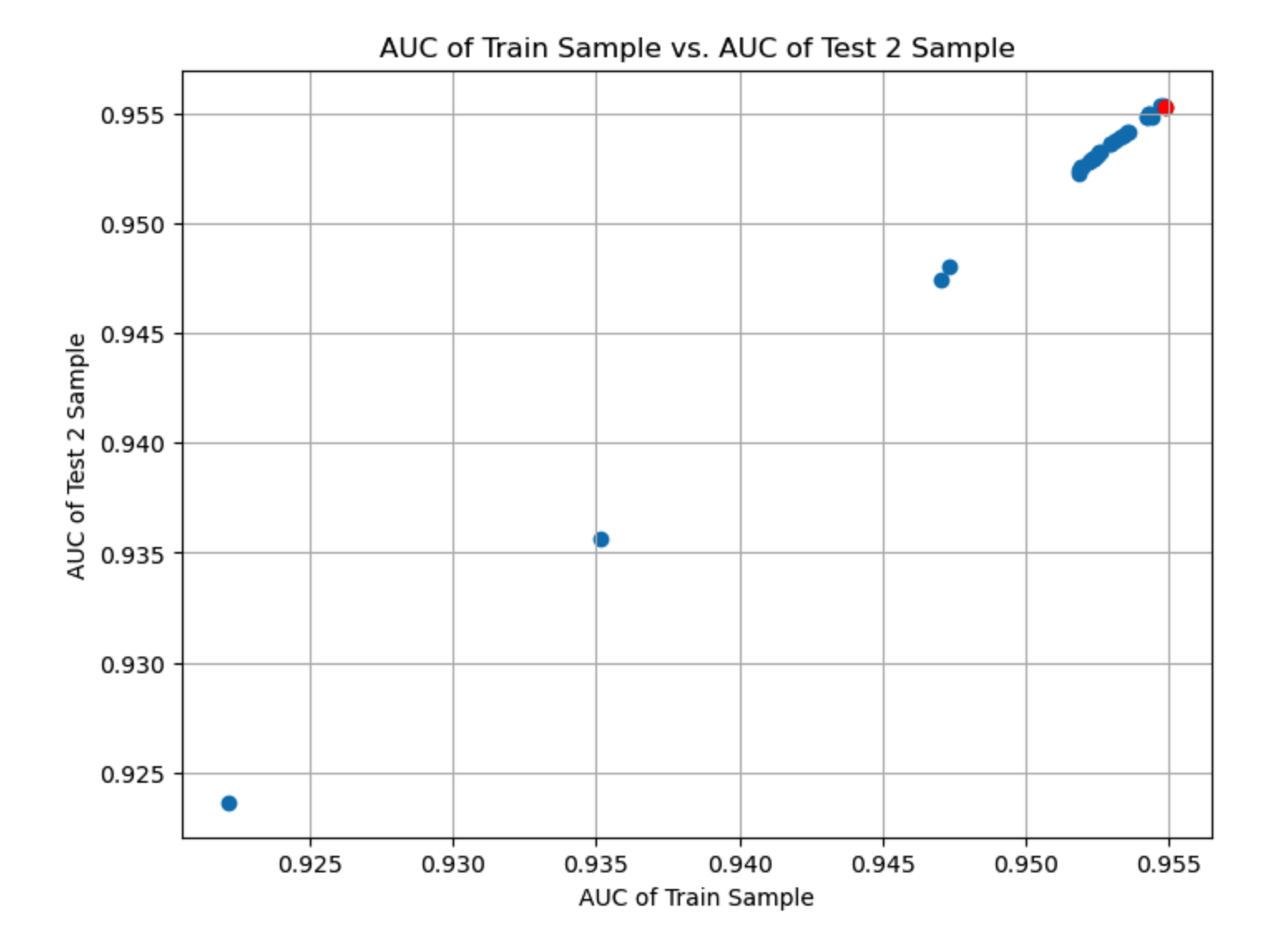
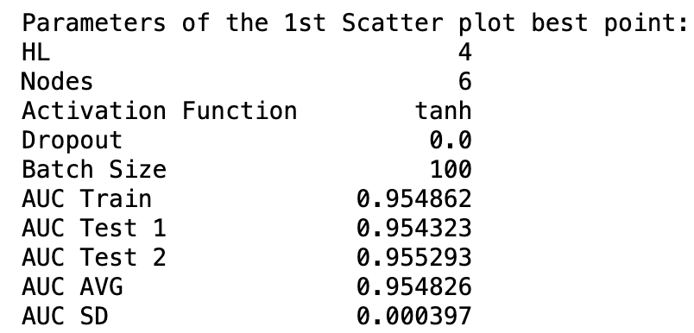
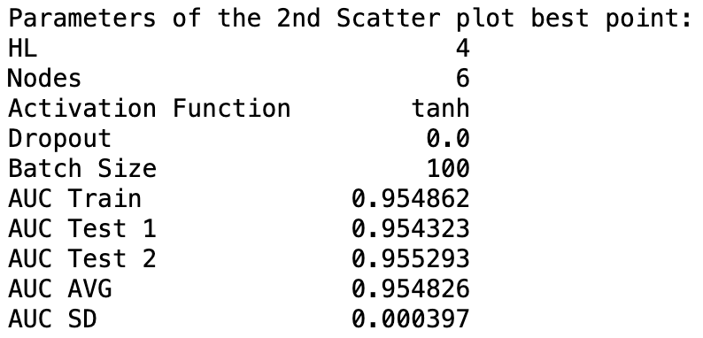
Neural Network - Grid Search

Slide 18
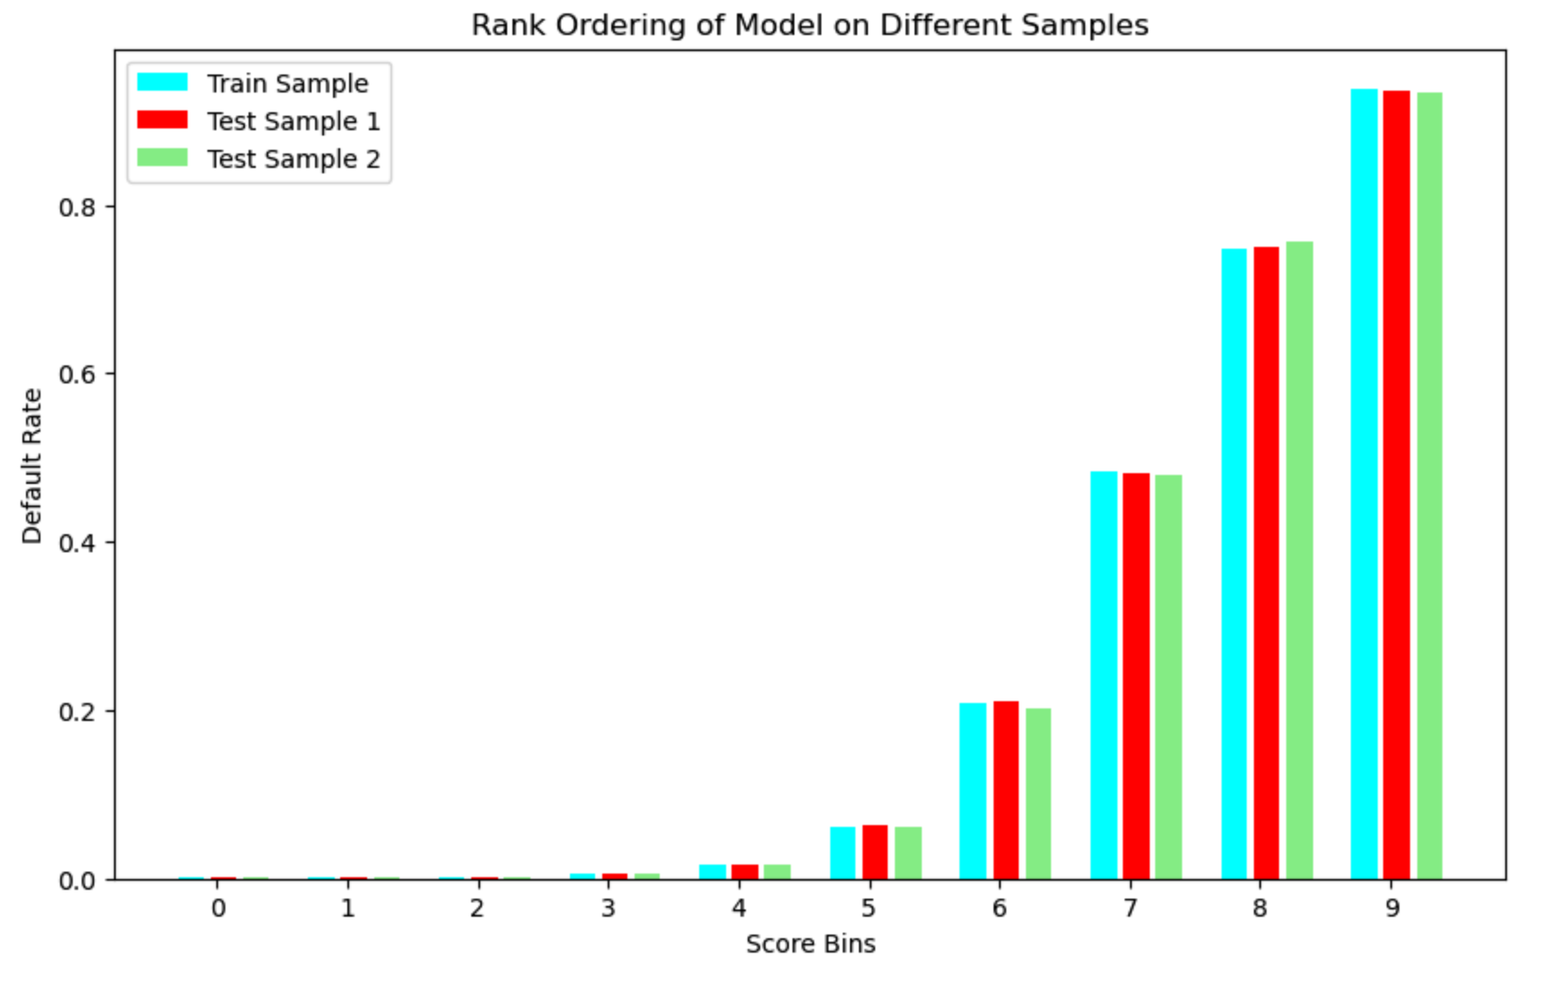
Neural Network – Final Model

Slide 19
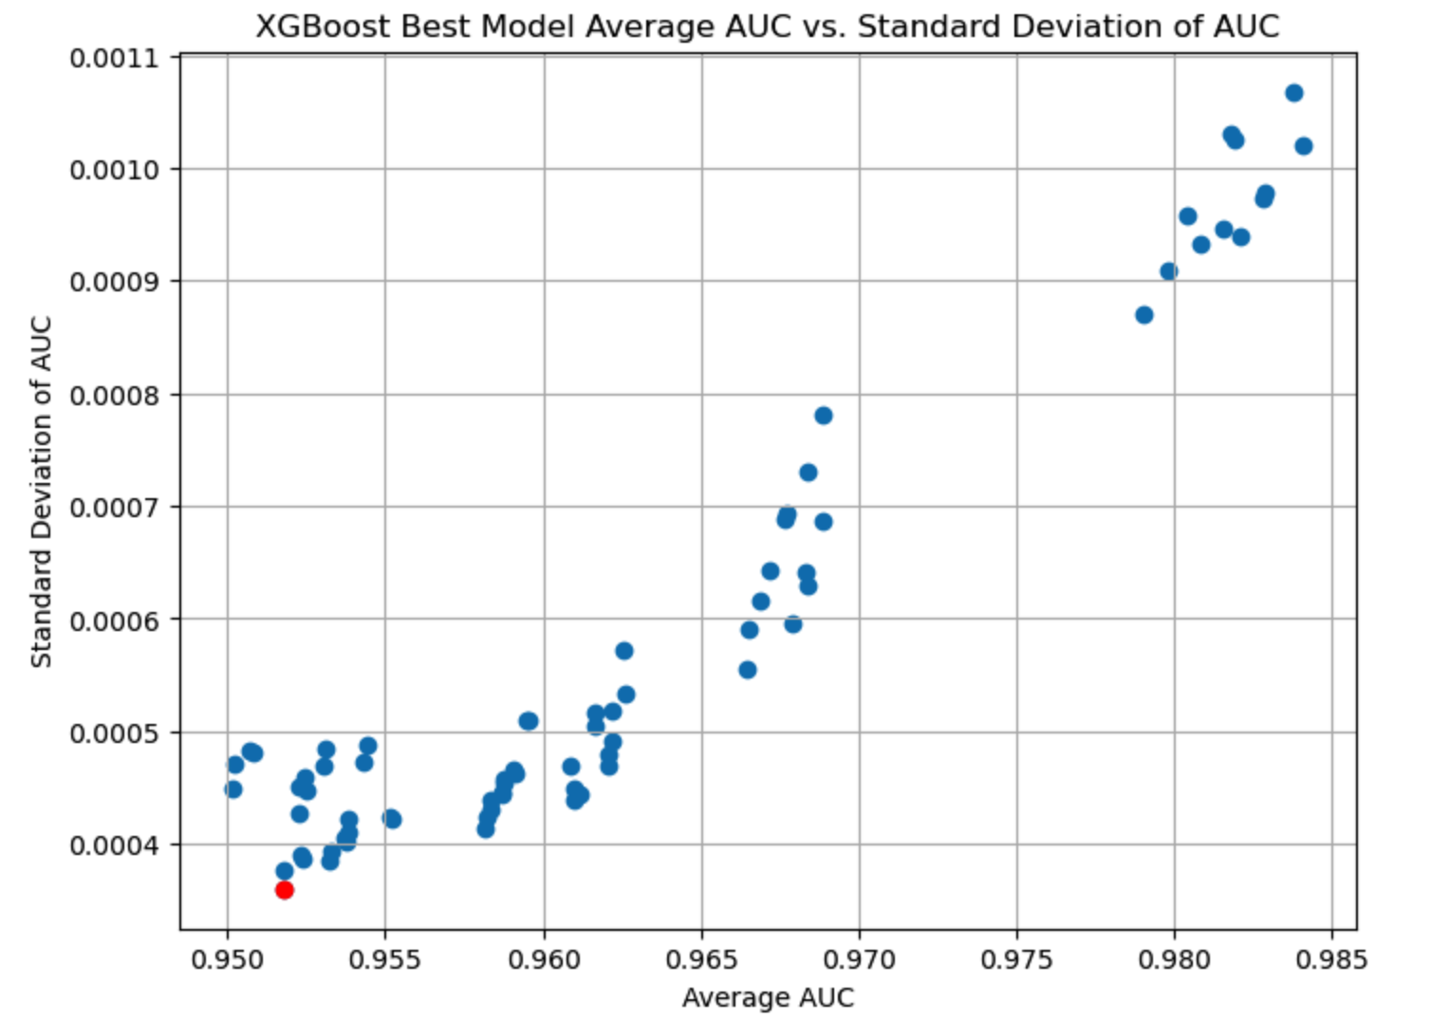
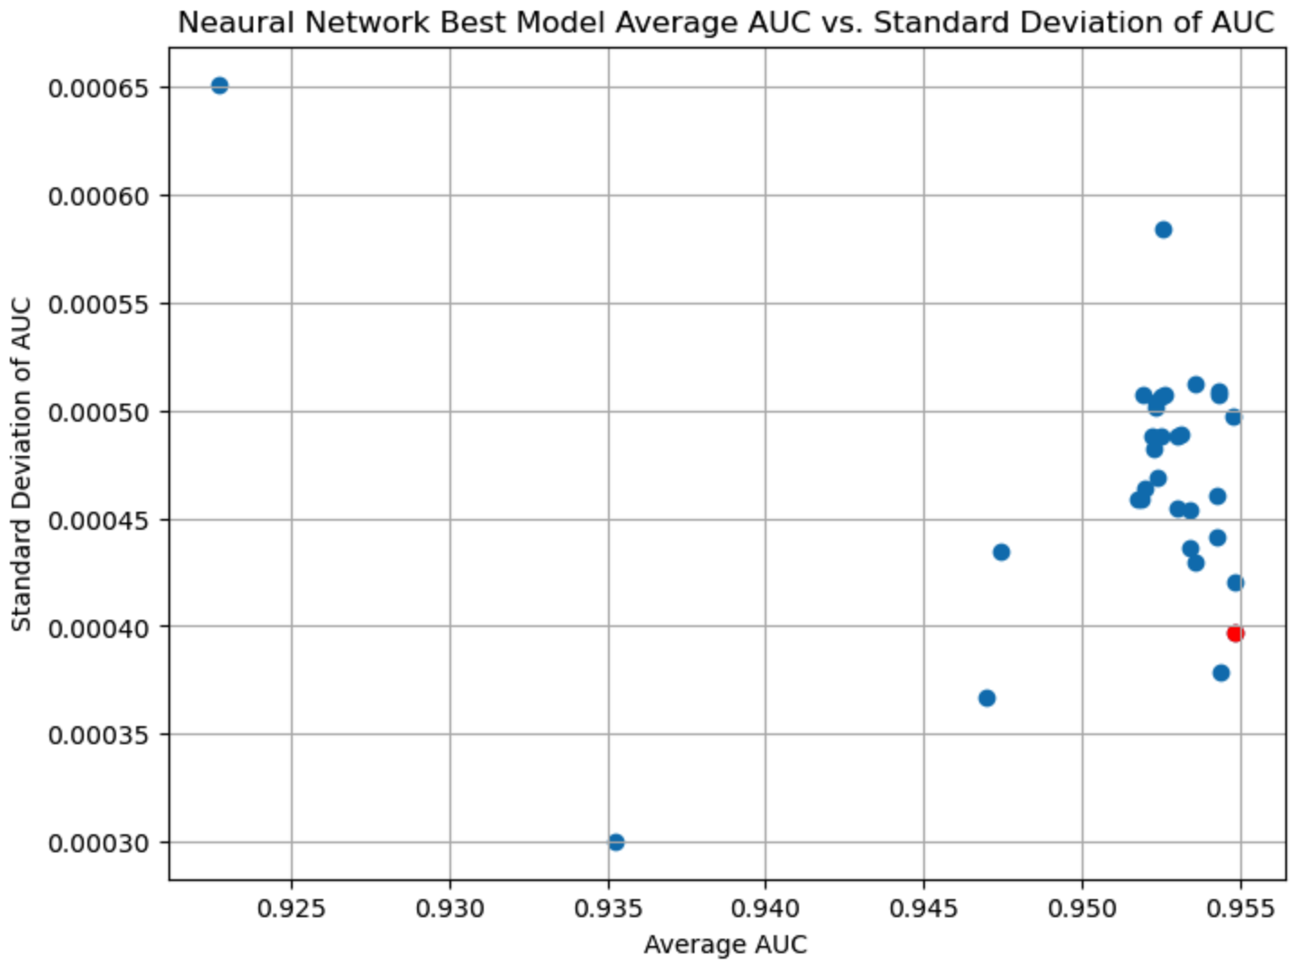
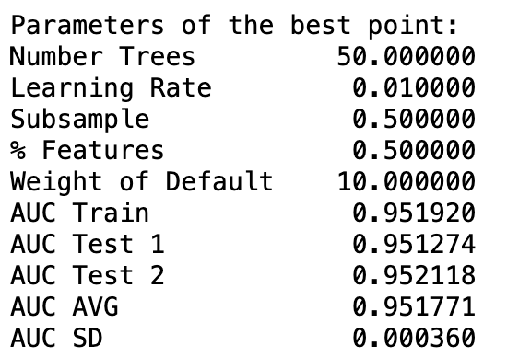
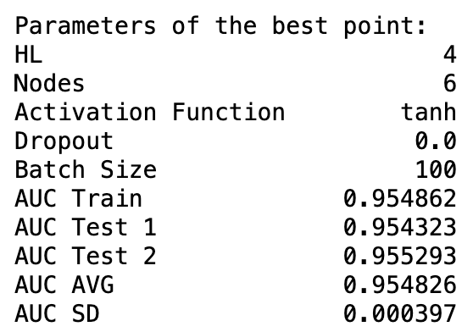
Final Model
Notes:
We have the graphs sd of auc vs avg auc of both The avg auc is high in nn than xgboost

Slide 20
Final Model
Reasons for Choosing the Neural Network:
Lower Standard Deviation Scores: Neural Network demonstrated slightly superior predictive performance compared to XGBoost, as indicated by higher AUC scores.
Flexibility in Model Architecture: The flexibility of Neural Networks in capturing complex patterns and relationships in the data, given the ability to adjust the number of layers and nodes is a plus feature.
Potential for Feature Learning: Neural Network has the capability to learn intricate features and patterns from the data, making it suitable for complex and nonlinear relationships.
Consistent Performance: Neural Network has consistent performance across different datasets, indicating robustness and reliability in predictions.

Slide 21
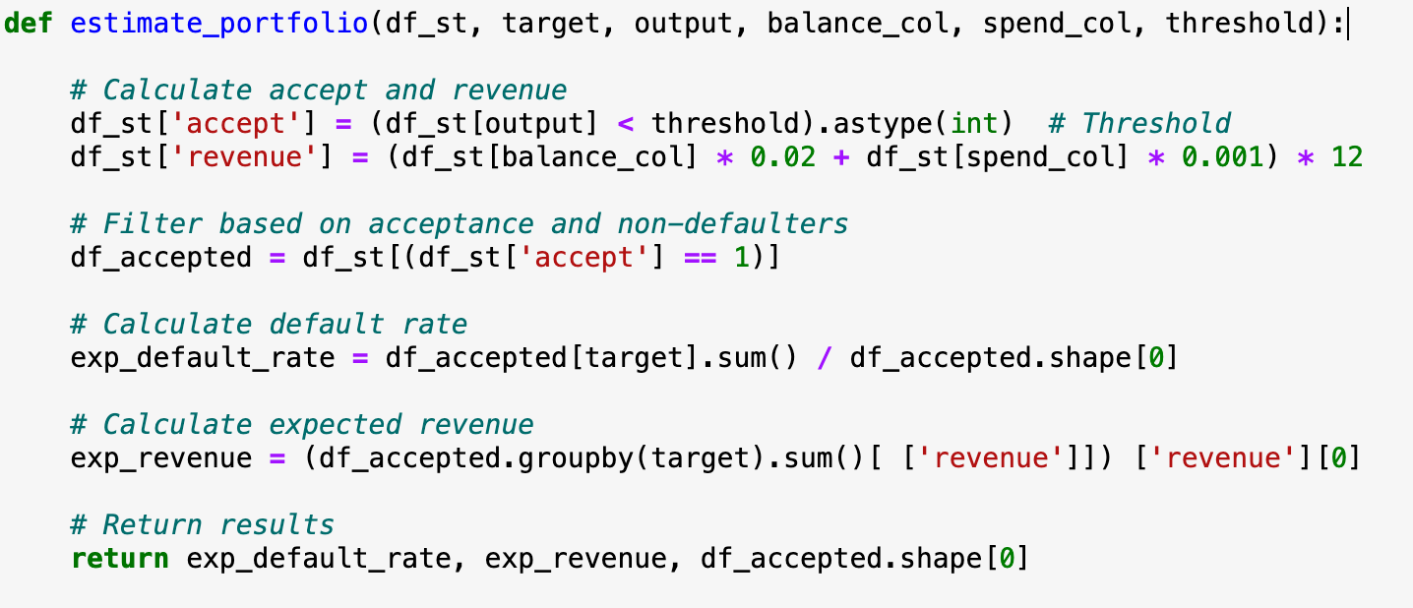
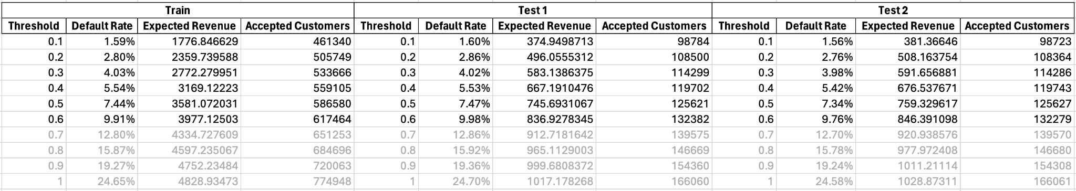
Strategy
Notes:
We used b1 , s7 over the past 6 months to calculate the revenue .
In doc less than 10 default rate was mentioned so stopped at 0.6 threshold.
Our conservative th is 0.5 and aggressive is 0.6
Why mid ? -

